Slide 1
Interactive Dashboard Design – Task 4
Name: Likhitha Yerraguntla
Elevate Labs – Data Analyst Internship
Tool Used: Power BI

Slide 2
Objective & Dataset Summary
Objective:
To design an interactive dashboard for business stakeholders using Power BI.
Dataset Summary:
- Dataset: Sample Superstore
- Records: 9,994
- Fields: Sales, Profit, Category, Region, State, Segment, Order Date, etc.

Slide 3
Page 1: Sales Overview
Insights:
- Total Sales and Profit KPIs give a quick business summary.
- Sales and Profit trends show seasonal performance.
- West region appears to be the most profitable overall.

Slide 4
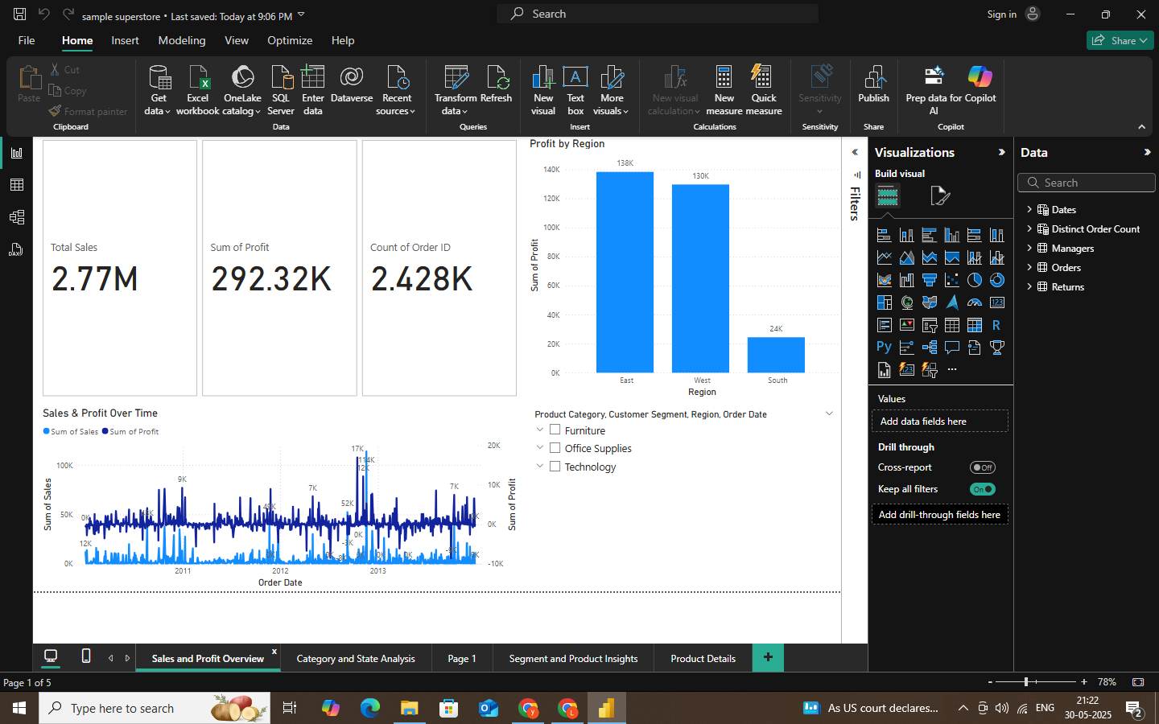

Slide 5
Page 2: Category & State Analysis
Insights:
- Technology category leads in both sales and profit.
- California is the top-performing state by revenue.
- Heatmap helps quickly identify high/low performing regions.

Slide 6
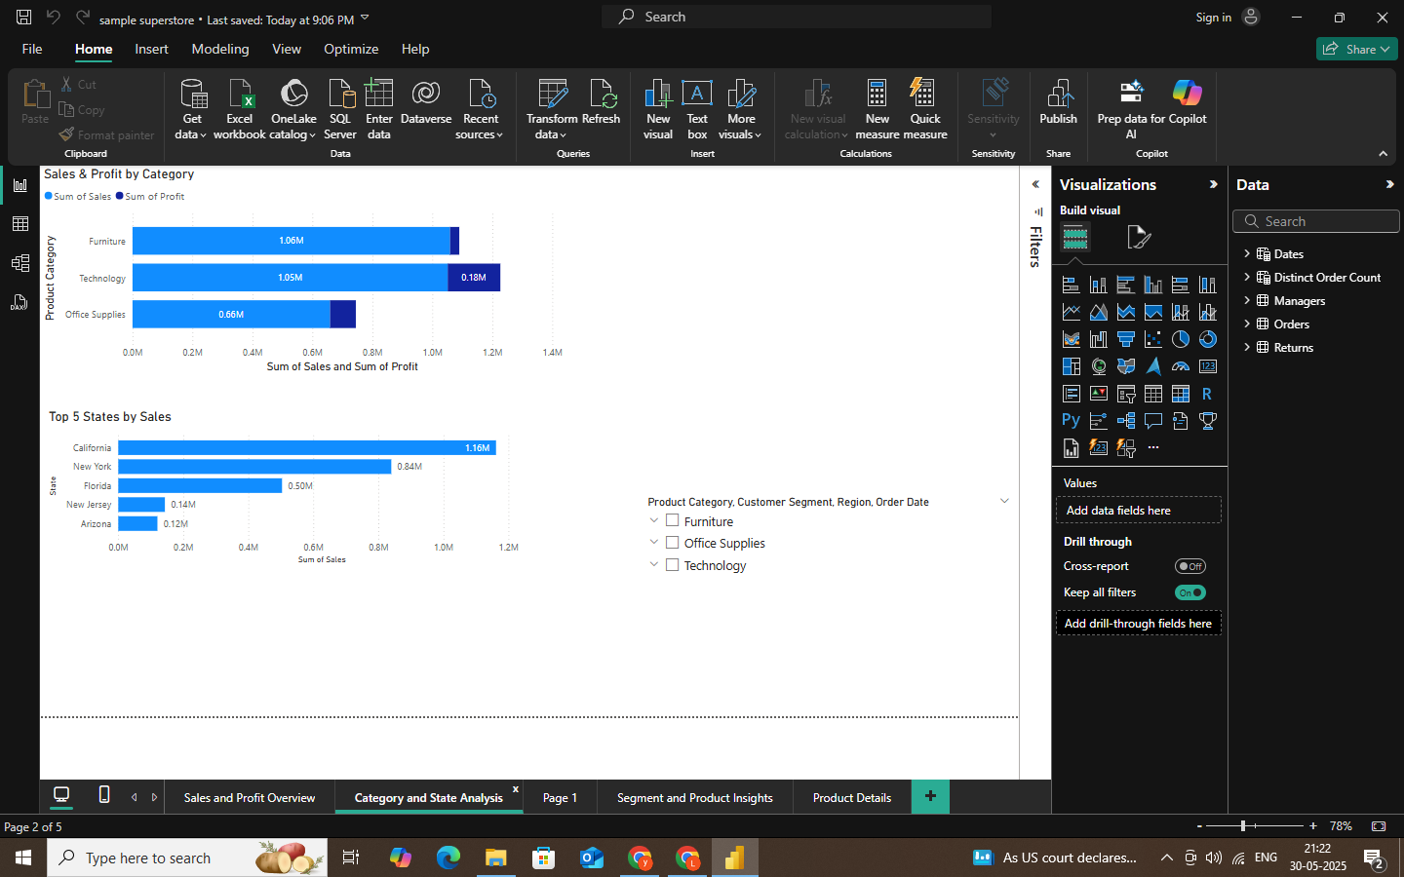

Slide 7
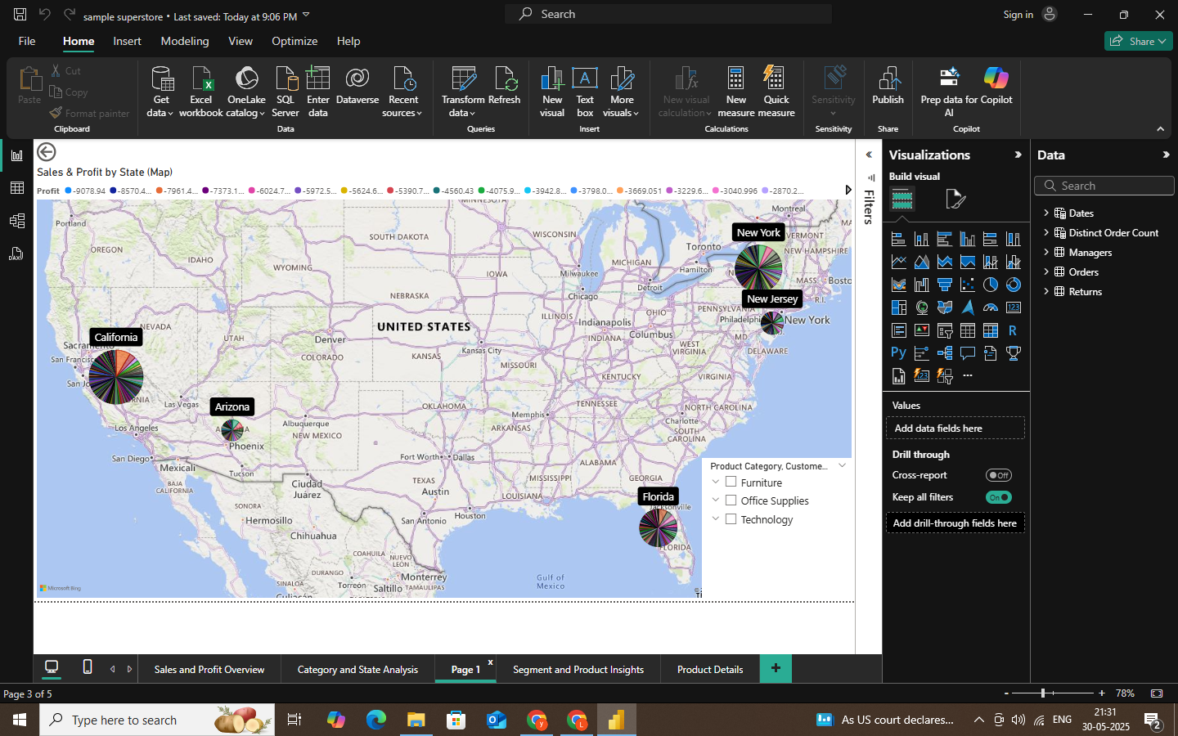

Slide 8
Page 3: Segment & Product Insights
📷Screenshot Placeholder
🔍Insights:
- Consumer segment contributes the highest sales.
- Top 10 products by profit highlight most valuable inventory.

Slide 9
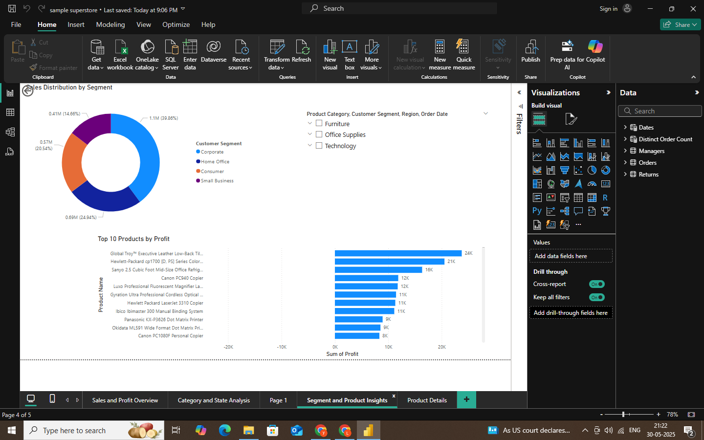

Slide 10
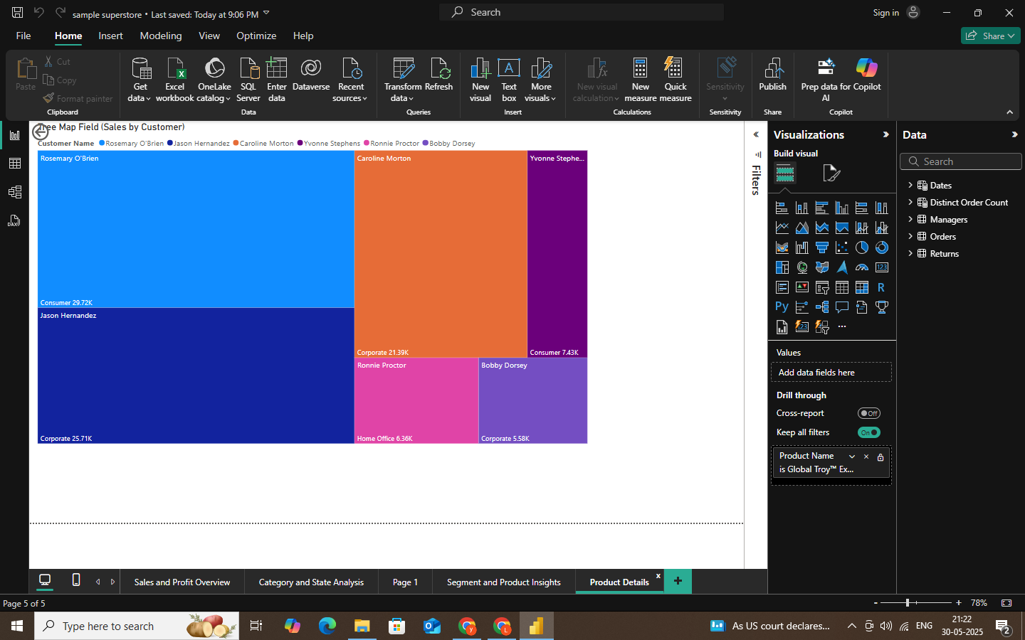

Slide 11
Conclusion & Learnings
Conclusion:
The dashboard enables data-driven decisions by summarizing key business performance areas.
Learnings:
- Creating KPI cards and trend charts
- Designing dashboards with filters and slicers
- Effective storytelling through visuals

